Slide 1
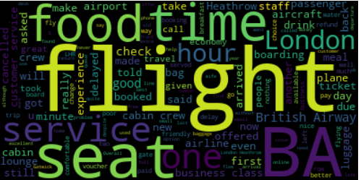
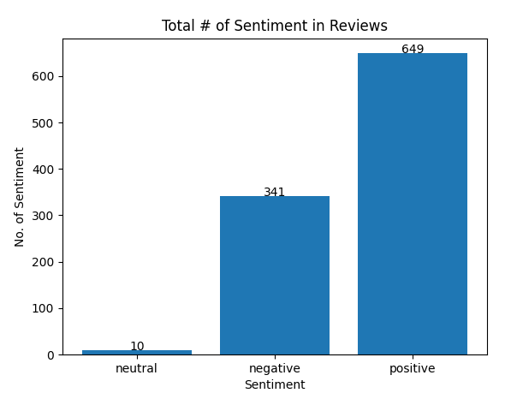
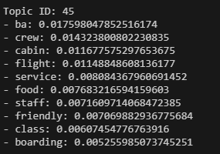
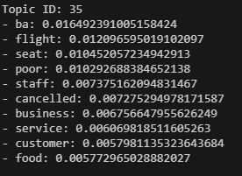
British Airways Insights
Collecting 1000 British Airways reviews, the reviews are shown to be mostly positive. 649 positive reviews, 341 negative reviews and 10 neutral reviews.
The wordcloud lists important aspects of the average British Airways experience.
Analyzing negative reviews, the generous consensus are customers complaining of flights being constantly cancelled or delayed with poor seats and service. While, also describing the food as nasty, in the economy class
Analyzing positive reviews, consensus among them is that the British Airways staff are friendly, while also praising its food.

